Slide 1
Week 2 – Lab B Linked Classes

Slide 2


Outline
Recap: classes
Linked classes

Slide 3
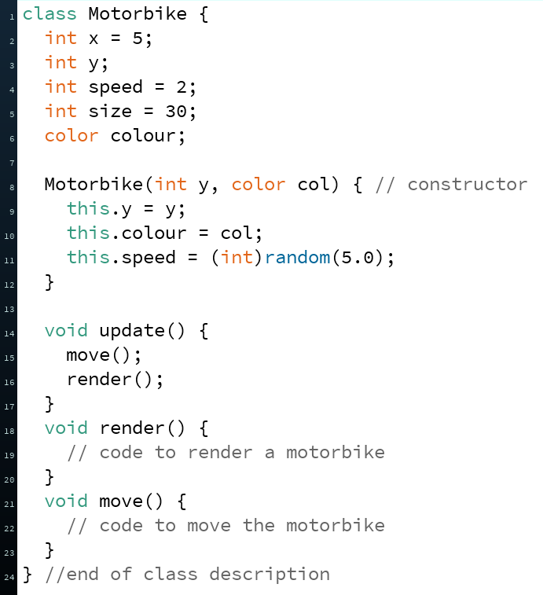
Recap: Classes
The classes we created in Programming 1 represented things
Motorbike
Defender
Alien
Every time we create a class, we are creating a brand new data type that we have defined
Because there was no built-in Motorbike data type in Processing, we created one from scratch
Recap: Classes
Linked Classes

Slide 4
Recap: Classes
Instance variables – typically nouns
Constructors
Called when using the new keyword
Classes typically have a few important members:
Instance Variables
Known by many other names – data, attributes, properties, fields (in some languages fields refer to static variables – will see examples later in unit)
Every instance (object) maintains their own copy of these variables
Methods
Procedures (void) or Functions (return a value e.g. int, boolean)
Methods define behaviour (things every object of that class will be able to do)
Constructor(s)
A special kind of method which is responsible for creating an object of the class
Methods –
typically verbs
Things the objects of that class can do
Recap: Classes
Linked Classes

Slide 5
Recap: Classes
Most of the classes we have been creating so far in Programming 2 have each contained a main method to allow each of those classes to run in isolation of each other
Typically, a project will contain one class with a main method which is responsible for ‘kick-starting’ the application, along with classes which represent the different entities in the program
Before we take a look at an example of this, let’s get familiar with a new type of diagram for visualising classes graphically – the UML class diagram
Recap: Classes
Linked Classes

Slide 6
UML: Class Diagram
The Unified Modelling Language (UML) is a way to graphically express an object-oriented design
Will be formally introduced in the lecture next week
One of the most popular UML diagrams is the UML Class Diagram
Let’s take a look at what the UML class diagram would look like for the very first class we created – the Motorbike class
Recap: Classes
Linked Classes

Slide 7
UML: Class Diagram
ClassName is written in bold and centred
Motorbike
x : int y : int speed : int size : int colour : int
update() : void render() : void move() : void
Variables
name : type
Methods
(with return types and any parameters)
Recap: Classes
Linked Classes

Slide 8
Linked classes
Recap: Classes
Linked Classes

Slide 9
Toy Demo
We will now create 3 classes
Toy class – will describe what a toy is
ToyChest class – will describe what a toy chest is (a collection of toys)
ToyChestDemo class – will contain the main method and will create some Toy objects and 1 ToyChest object
Recap: Classes
Linked Classes

Slide 10
Toy Class
Toy
name : String weight : double
printDetails() : void
Toy class represents a single toy
Every toy has two things:
Name of the toy - String
Weight of the toy in grams - double
Every toy can tell us about itself – printDetails method (prints to console name and weight)
public class Toy {
String name; // name of toy
double weight; // grams
Toy(String name, double weight) {
this.name = name;
this.weight = weight;
}
void printDetails() {
System.out.println("Toy name: " + name);
System.out.println("Toy weight: " + weight);
}
}
Recap: Classes
Linked Classes

Slide 11
ToyChest Class
ToyChest
toys : ArrayList<Toy> weight : double
addToy( t : Toy )
Toy chest will represent a chest that can contain Toys
ToyChest has two things:
A list of toys currently in the chest (Using an ArrayList to store toys)
The weight of all toys currently in the chest
Can add a toy to the chest (the ArrayList) by calling the addToy method (which accepts a toy)
import java.util.ArrayList;
public class ToyChest {
ArrayList<Toy> toys;
double weight;
ToyChest() {
toys = new ArrayList<Toy>();
}
void addToy(Toy t) {
toys.add(t);
weight += t.weight;
}
}
Recap: Classes
Linked Classes

Slide 12
ToyChest Class
ToyChest
toys : ArrayList<Toy> weight : double
addToy( t : Toy )
White diamond symbol – aggregation – “has-a” relationship
1 ToyChest can contain zero to many toys
1
0..*
Toy
name : String weight : double
printDetails() : void
Recap: Classes
Linked Classes

Slide 13
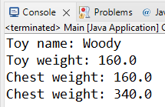
public class ToyChestDemo {
public static void main(String[] args) {
Toy toy1 = new Toy("Woody", 160);
Toy toy2 = new Toy("Buzz", 180);
ToyChest chest = new ToyChest();
chest.addToy(toy1);
toy1.printDetails();
System.out.println("Chest weight: " + chest.weight);
chest.addToy(toy2);
System.out.println("Chest weight: " + chest.weight);
}
}
ToyChest
toys : ArrayList<Toy> weight : double
addToy( t : Toy )
1
0..*
Toy
name : String weight : double
printDetails() : void
ArrayList of Toys
0
1
toys
chest
0.0
160.0
weight
340.0
name
Woody
name
Buzz
toy1
weight
160.0
toy2
180.0
weight
Recap: Classes
Linked Classes

Slide 14

Summary
Recapped Classes – a design for which objects are based on
A class can have instance variables of both primitives types and can also have references to other objects
UML – Unified Modelling Language
Many types of UML diagrams
We saw the UML class diagram for graphically representing a class
Recap: Classes
Linked Classes

